Slide 1


Slide 2


Laptop price analysis
By:-
GOGULA VINAY,
KANCHERLA MANIKANTA.
Batch 168.

Slide 3
Self introduction.
Name : Gogula Vinay.
Work Exp: 1Year in Volvo-CE.
Educational Background:- Mechanical Engineering (8.7 CGPA).
Data science has emerged as a leading career path across many sector. We need to learn Data Science in order to create better solutions for real-world problems that we are facing day to day life.
Innomatics provides Offline data science course, and mentoring support for clearing the doubts, Will be provided practice sessions.
Name: Kancherla Manikanta.
Work Exp:0(Fresher).
Educational Background: Electronics and Communication Engineering (7.0CGPA).

Slide 4

What is Web Scraping?
Web scraping is the process of retrieving or “scraping” data from a website.
Web scraping helps collect these unstructured data and store it in a structured form.
This information is collected and then exported into a format that is more useful for the user.
We used python for web scraping .
Libraries used for Web Scraping.

Slide 5





Steps involved...
Data Collection
Data Cleaning
Data Analysis
Data
visualization
conclusion

Slide 6
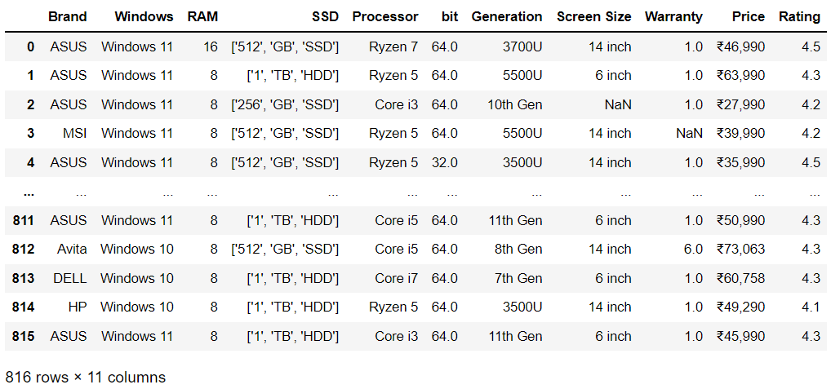
Data frame after data collection.

Slide 7
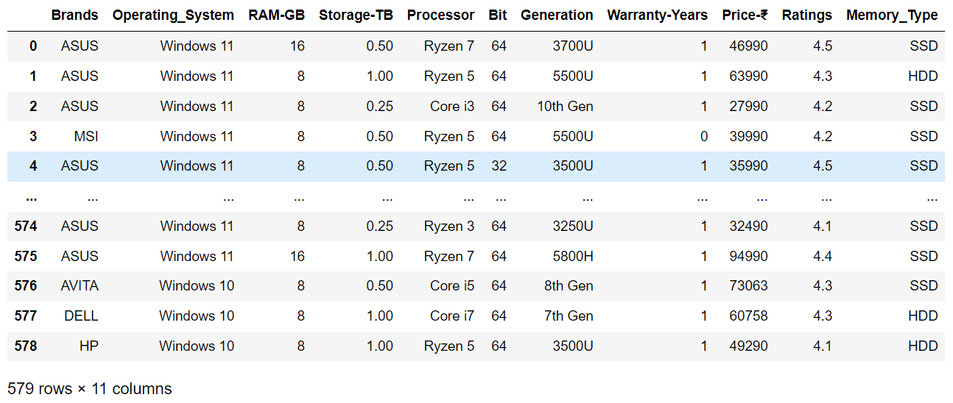
After cleaning the data frame.

Slide 8
Steps in cleaning Process.
Removing Brackets and special symbols.
Dealing with Duplicate rows.
Dealing with Nan’s.
Filled all the nan in warranty with no warranty.
And the other columns with the mode in categorical column , mean in numerical columns.
Converting the Storage values from GB to TB.

Slide 9
CFb… 369…
Categorical Columns.
Numerical Columns.
Brands.
Operating System.
Processor.
Generation.
Memory Type.
Ram.
Storage.
Bit.
Warranty.
Price.
Ratings.

Slide 10
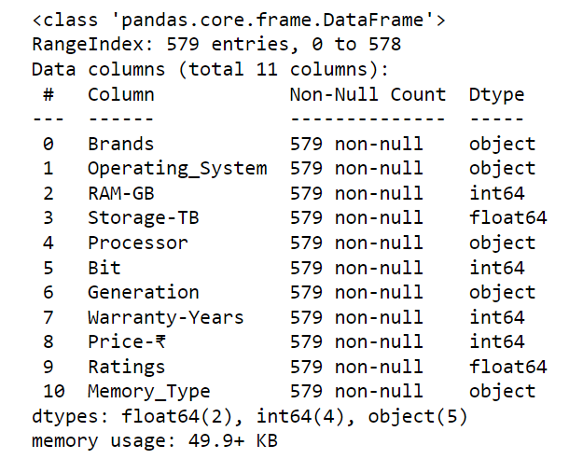
Basic info of our Data Frame.

Slide 11
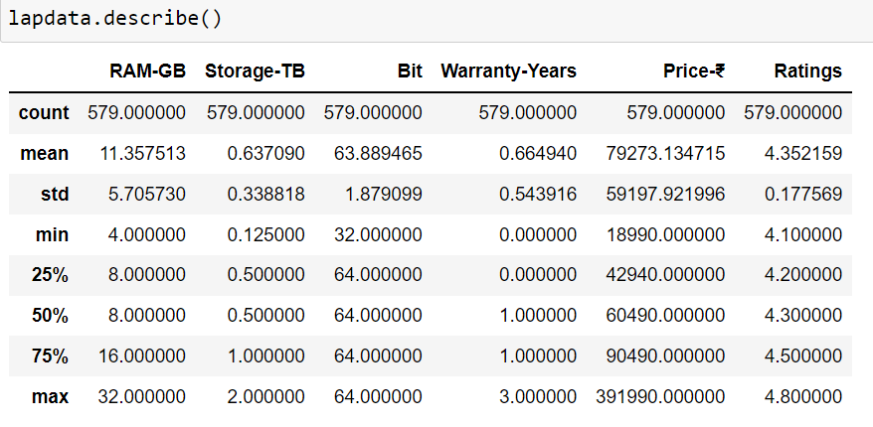
Descriptive Statistics.

Slide 12
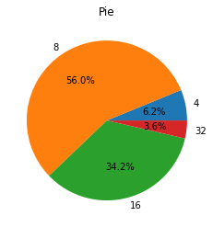
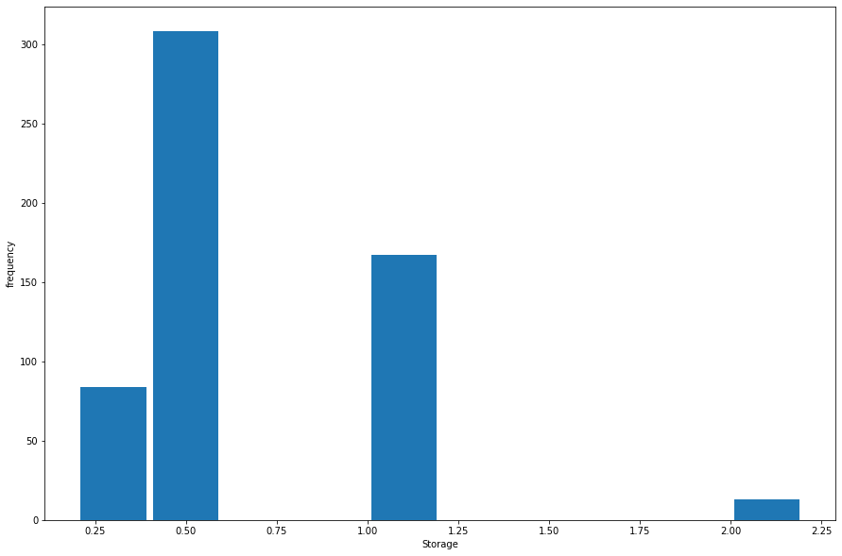
Ram in GB.
Storage in TB.
We observed that most of the laptops contain 56% of 8GB Ram and ~35% of them are 16 GB.
From this Histogram Nearly 300 Laptops contain 500GB Storage.

Slide 13
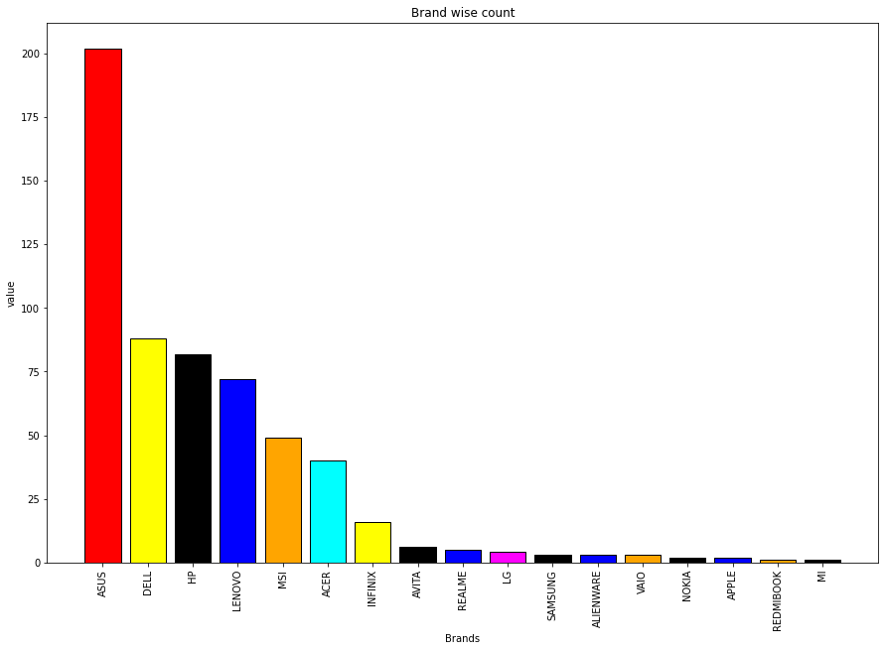
From this bar plot, in our Data Frame most of laptops are ASUS Brand around 200 and the least MI and Redmibook are 1.

Slide 14
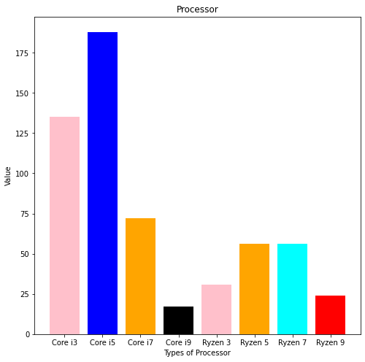
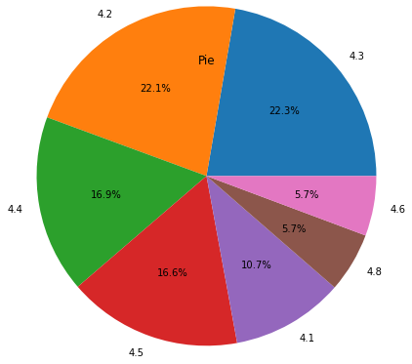
Ratings.
Most of the Ratings are 4.3 with 22.3%.
There are around 175 laptops with core i5 and least are 17.

Slide 15
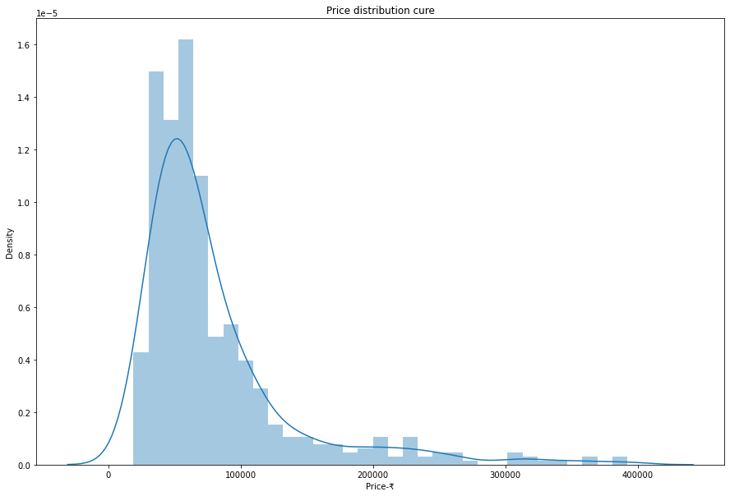
12 % of the laptops lies in range of 50k to 70k of prices.

Slide 16
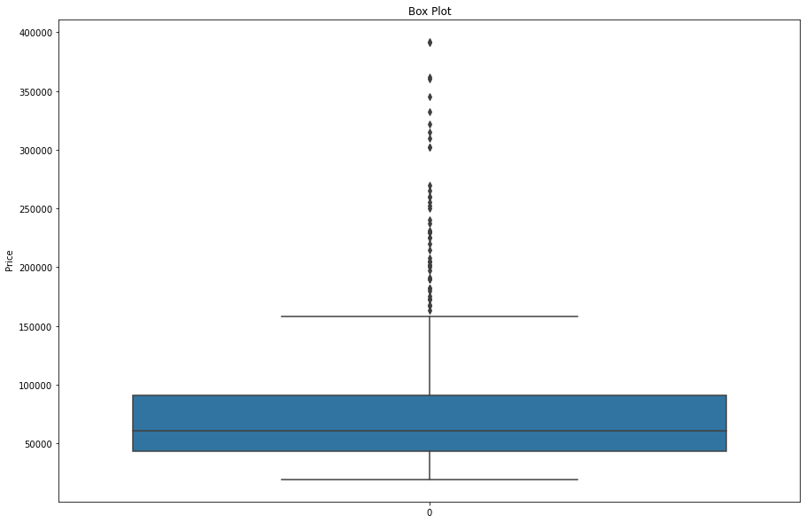
Most of the laptops in range of 50k to 1Lac and we observe there are few are outliners are observed and the ASUS is the top rated laptop.

Slide 17
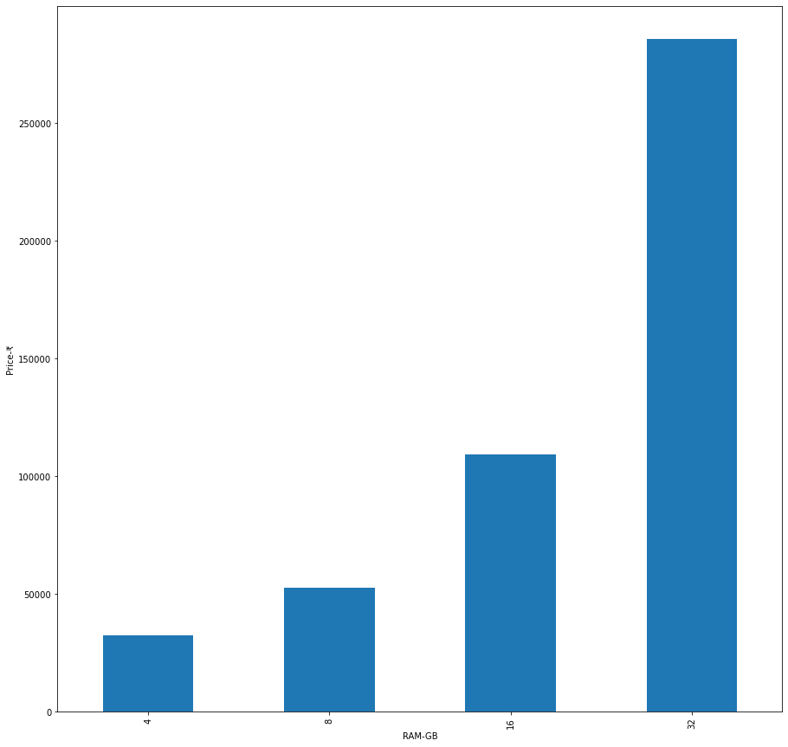
Price Analysis on RAM.
Highest rated laptops contain 32 GB RAM and 2.7Lac and 4 Gb ram with 20 to 30k.

Slide 18
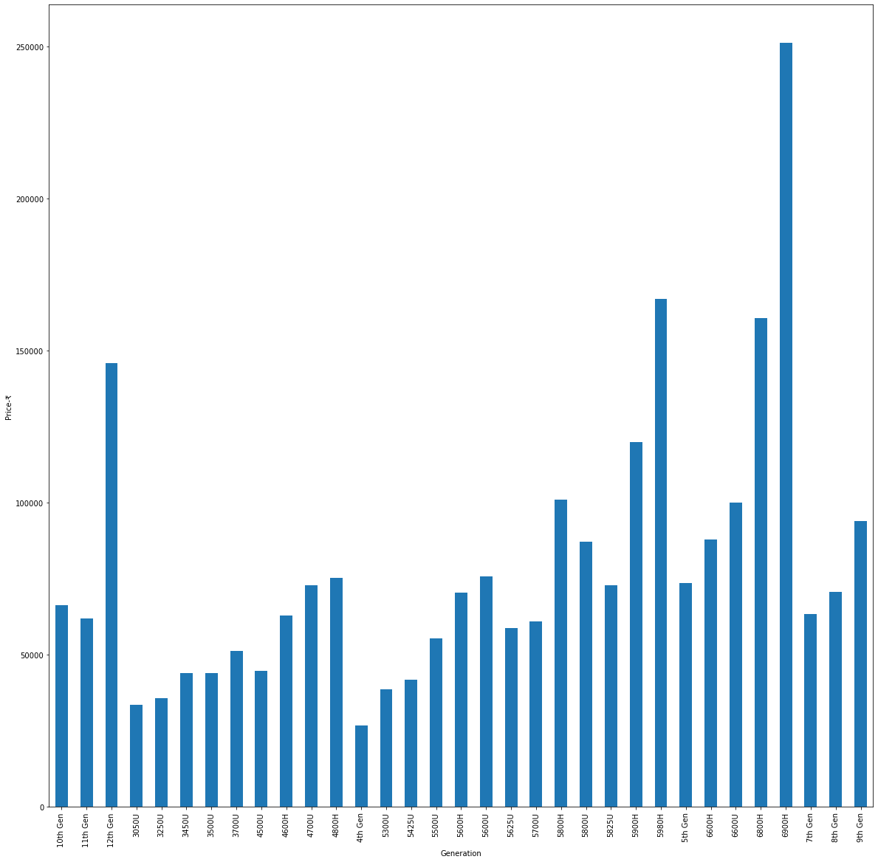
Price analysis on Generation.
6900H Generation and they belongs to ASUS Brand.

Slide 19
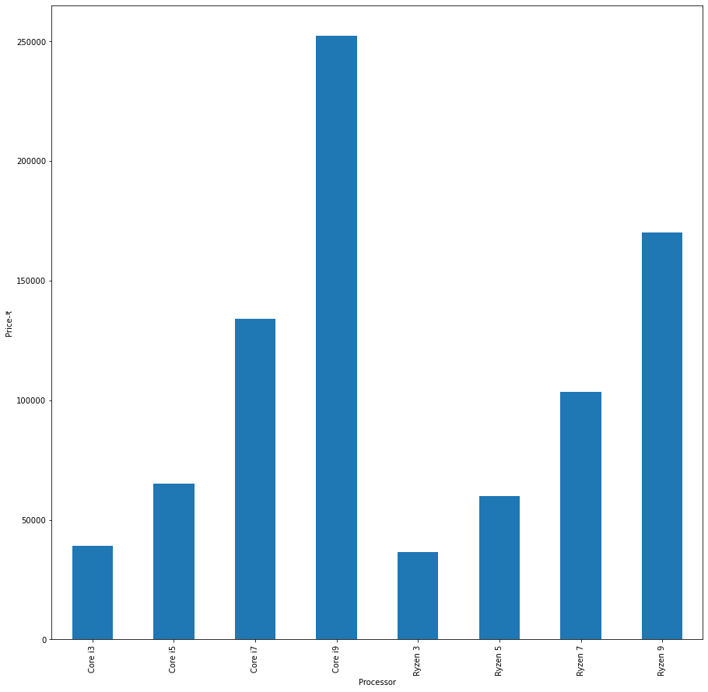
Price Analysis on Processor.
Core i9 has highest rating with 2.5Lac.

Slide 20
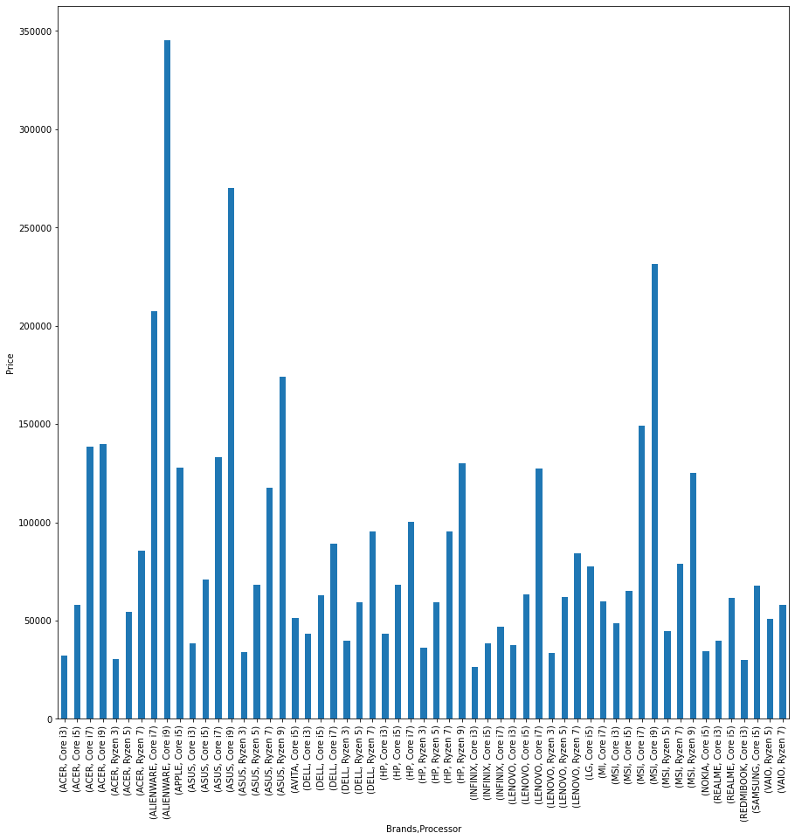
Price analysis on brand and Processor.
ALIENWARE laptop with Core i9 contains the high mean price.

Slide 21
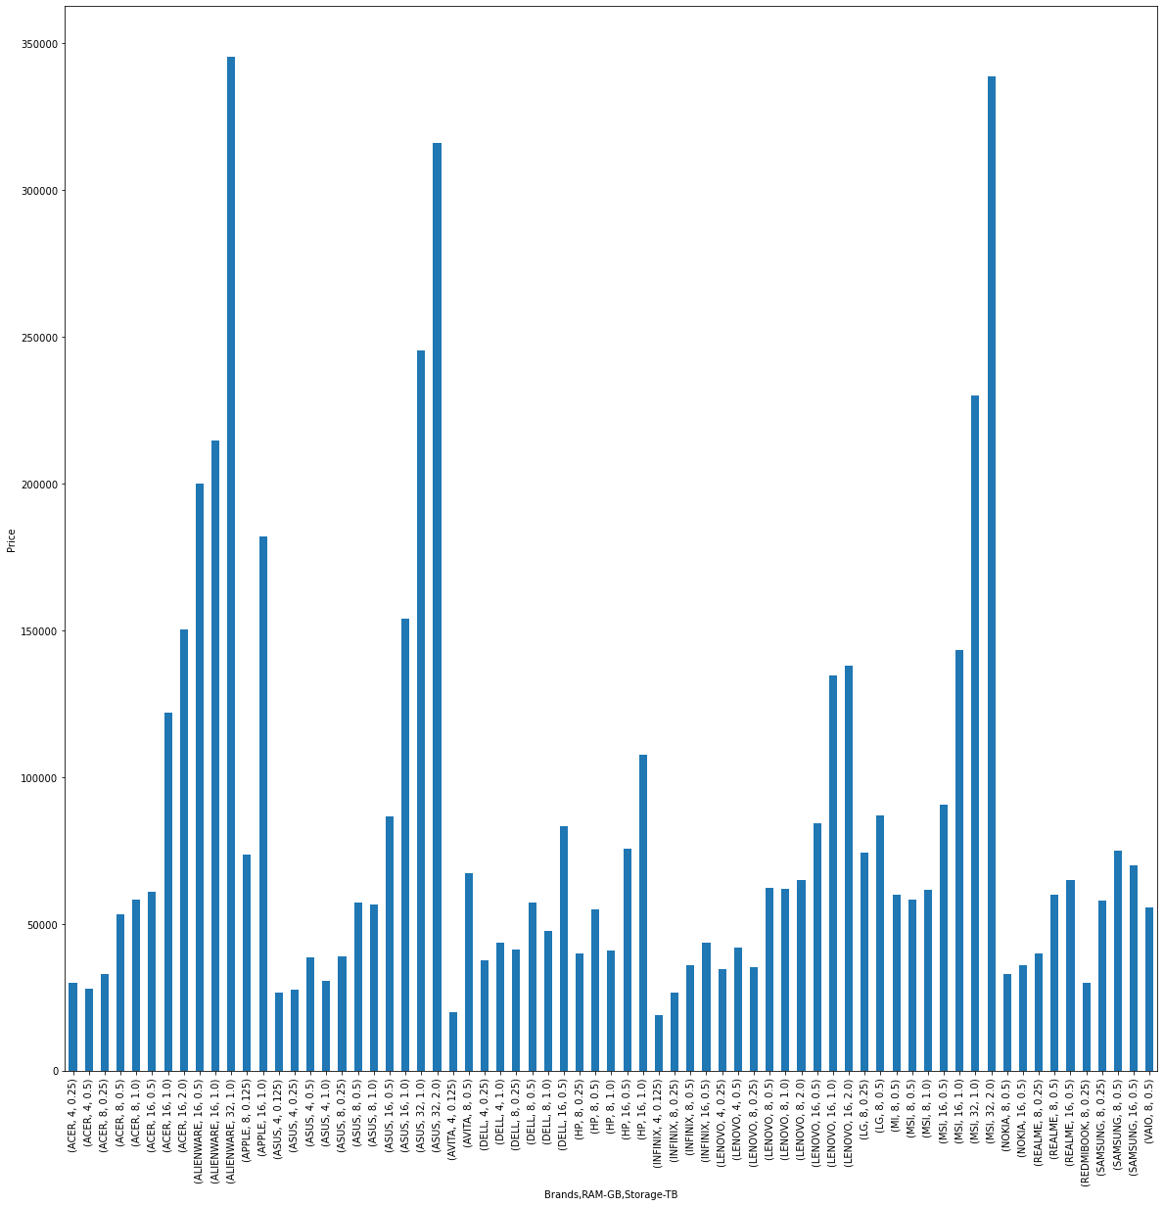
Price analysis on brand and RAM, Storage.
ALIENWARE 32 RAM, with 1TB Storage, ASUS 32 GB RAM, 2TB Storage.

Slide 22
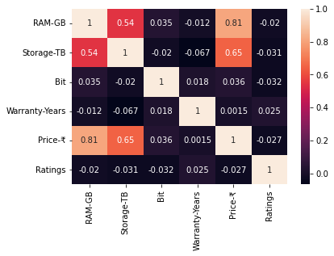
Correlation.
By correlation plot the correlation between Ram-Price and Storage-Price are having Strongly positive relation with 81 and 65% , and strongly negative are -0.027 ratings vs price.

Slide 23
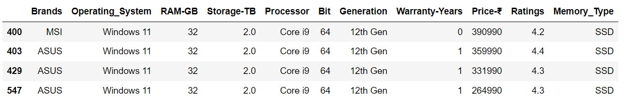
Laptops that are available with the least price.
Laptops that are available with the maximum price.
Laptops with the required OS, Ram, SSD, Processor , Bit and Gen Specifications.

Slide 24
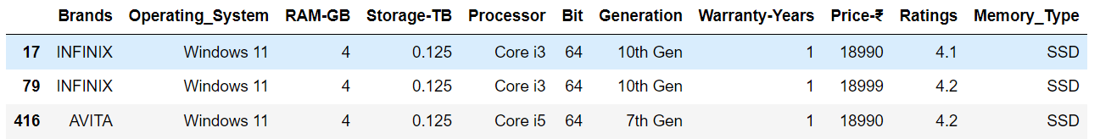
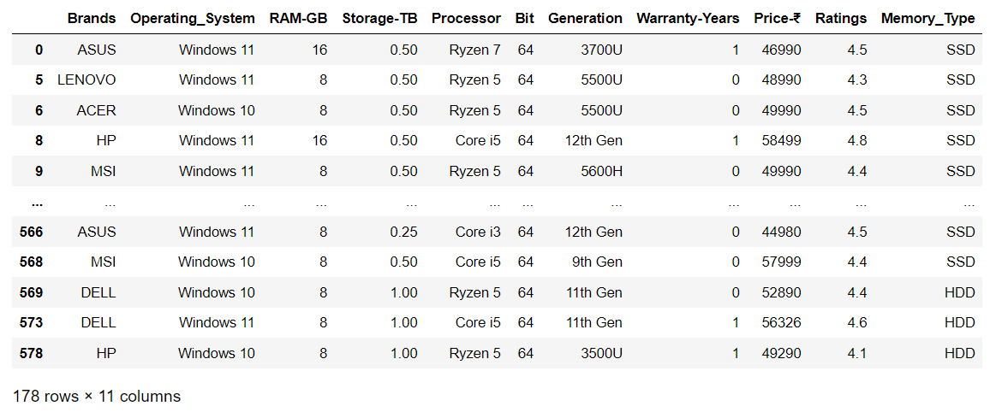
Selecting the laptops with 4GB Ram,125GB SSD and price less. then 20k
Laptop budget amount of Rs40,000–60,000 and user product rating.

Slide 25
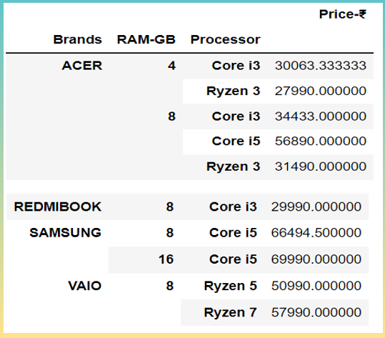
Price Analysis on Brand, Ram and Processor: Pivot Representation.

Slide 26

Conclusion:
By correlation plot the correlation between Ram-Price and Storage-Price are having Strongly positive relation with 81 and 65%.
We found that, the best laptops by considering key factors like the budget amount of Rs40,000–60,000 are around 170 laptops.
We conclude out of different Specification parameters Ram and the Storage decides the Price of a Laptop.

Slide 27


